Slide 1
Subject Name : UNIX Subject Code : IC-405 Course Name : MCA (6 Years) IV Semester Faculty Name : Arpit Neema

Slide 2
History of UNIX
UNIX versions can be broadly divided into two different schools –
The System V school from AT &T Bell Laboratories
The Berkeley school from the University of California, Berkeley.
UNIX operating system was originally designed by Ken Thompson and Dennis Ritchie at AT & T Bell Laboratories in 1969. Early UNIX suggested the name UNICS (Uniplexed Information and Computing System)
In 1970, UNICS finally became the name by which it’s known today- UNIX. Conti….

Slide 3
It evolved from time sharing operating system called MULTICS (Multiplexed Operating and Computing System)in order to fulfill the programming requirements of that time.
Originally UNIX was written in assembly language but was recoded in 1973 in ‘C’ afterwards.
Writing the system in C made it possible to maintain it and move it to different hardware platforms.
Although UNIX is written in ‘C’ language, it supports other languages like Fortran, Pascal, Cobol, Lisp, Basic and Prolog.
It can support any language that has a compiler or interpreter and a system interface that maps user requests to standard set of requests on UNIX. Conti….

Slide 4
Conti….
Apart from AT&T, most of the solid features available on UNIX system because of University of California, Berkeley (UCB).
Berkeley didn’t like most of the AT&T UNIX, and created a UNIX of its own. They called it BSD UNIX (Berkeley Software Distribution).
These versions became quite popular worldwide, especially in universities and engineering circles.Their latest version is known as 4.3 BSD.
Conti….

Slide 5
Conti….
Berkeley filled the gaps left behind by AT&T and later decided to rewrite the whole thing in the way they wanted.
It was a young student (Bill Joy) who wrote what eventually was to become the standard editor of UNIX system(vi) and a very popular shell (C Shell).
Berkeley also had a better file system, a more versatile mail feature and a better method of linking files.
Later they also offered with their standard distribution a networking protocol software (TCP/IP) that made the internet possible. Conti….

Slide 6
Conti….
The earlier products of AT & T were known as “Editions” then changed to “System”.
In 1982 , they had System III, which became System V Release 3.0 in 1987 and finally Release 3.2.

Slide 7
Other Version related to UNIX
Apart from AT&T, Microsoft and Sun microsystems were the other notable actors to play significant roles in UNIX. Sun used the BSD System as a foundation for developing their own brand of UNIX(the SunOS).Its major contribution is the Network File System(NFS).Today their version of UNIX is known as Solaris and is SVR4-based.
Microsoft was the first to run UNIX on a PC with 640 KB of memory.They called their product XENIX that was based on earlier edition of AT&T,but some BSD-borrowed utilities.
XENIX was later sold off to SCO (The Santa Cruz Operation),who today markets the most popular commercial brand of UNIX for the desktop-SCO UNIX. It now offers two major flavors-SCO Open Server Release 5 and SCO UnixWare 7 the later is SVR4-Complaint.
Conti….

Slide 8
System V Release 4 (SVR4)
AT&T introduced SVR4 (System V Release 4) to merge their own version, the Berkeley and Microsoft variant. Both Bell Laboratories stopped further work on UNIX, and UNIX now is a trademark of the X/Open consortium.
SVR4 is combination of System V 3.2, BSD, SunOS and XENIX.
In response to the AT&T announcement IBM, Hewlett-Packard and Digital Equipment Corporation (DEC) decided to form an association of their own .This association was the Open Software Foundation(OSF) and was formed to create their own brand of UNIX like :-

Slide 9
Conti….
Hewlett-Packard HP-UX
Apple AUX
Amdahl UTS
Cray UNICOS
IBM AIX.
Every vender called its product the “true” UNIX as if there was such a thing
called a true UNIX.
A number of significant developments in UNIX have taken place in the last
couple of the years.

Slide 10
In 1992, AT&T’s UNIX business was sold off to Novell.
The people who produced the NE2000 networking standard and a networking software called Netware.
Later Novell turn over the UNIX trademark to a standards body called X/OPEN who currently own it. The consequences is that today UNIX is no longer a product, but a standard.

Slide 11
A Brief Intro of LINUX
Linus Torvalds is the father of Linux, the free UNIX that is now making significant inroads into the commercial world.
Linux is particularly strong in networking and Internet features and is an extremely cost-effective solution in setting up a web site or a local intranet.
The multimedia capabilities of Linux were exploited by James Cameron who used 200 Linux machines “in parallel” to cerate the visual effects in Titanic.
Linux is the freeware version of UNIX that has become popular.

Slide 12
Conti….
Some Important Version of UNIX running in the market :
SCO UNIX Open Server Release 5
SCO Unix Ware 7 (SCO’s Implementation of AT&T’s SVR4 (Standard)
Some Famous version of LINUX
Red Hat Linux 5.0
SuSE Linux 5.1

Slide 13
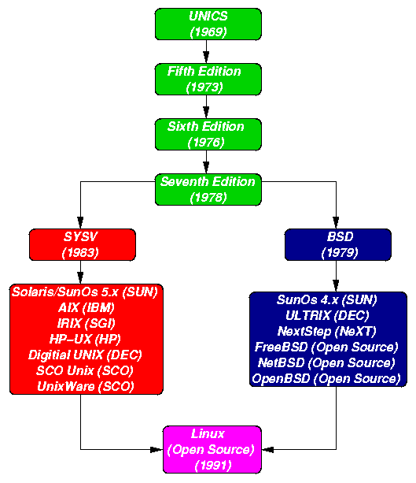

Slide 14
UNIX Philosophy
Make each program do one thing well. Reusable software tools: 1 tool = 1 function.
Expect the output of every program to become the input of another, yet unknown, program to combine simple tools to perform complex tasks.
Prototyping : Get something small working as soon as possible and modify it incrementally until it is finished.
A unique characteristics of UNIX is the large collection of commands or software tools that is provides. This is another expression of the basic philosophy. Conti….

Slide 15
Conti….
The two illusions are supported here with UNIX are :
“Files have places and processes have life.”
The first statement assumes that files are situated in space which makes it
easy to locate them with reference to a predefined place. Moreover you can
be ”placed” at a specific location in the file system and you can also “move”
from one place to another. This real life models makes UNIX file system
easily comprehensible.
Before understand “Processes have life” we see the three
meaning of process which are as follows :
1. It is an active entity.
2. It is a program in execution.
3. A program can be a process and a program can have n number of
process.
Therefore Process have life, they have parents, children and grandchildren and are born, even reborn and die.

Slide 16
Conti….
Before understand “Processes have life” we see the three
meaning of process which are as follows :
1. It is an active entity.
2. It is a program in execution.
3. A program can be a process and a program can have n number of
process.
Therefore Process have life, they have parents, children and grandchildren and are born, even reborn and die.

